Slide 1
Controlled Battery discharge system
Department of Industrial engineer
Cristiano Strobbe
I.D. 196763
Industrial electronics and instrumentation course a.a. 2017/2018

Slide 2
Introduction
The goal of this project was to build an instrument that identifies the electrical/thermal parameters of a Li-Ion cell’s model.
The model are then used to estimate the SoC (State of Charge) of a battery for a Formula SAE car.
The identification process can be done in several ways, the one that I choose was using discharge pulses.
The requirements for this instrumentation were:
Be able to discharge at least one battery module with different current profiles (pulse, ramp etc.).
High discharge current (almost 240A – Full car throttle)
Cheaper as possible (1000 euros budget)
Acquire and store batterie’s voltages, batterie’s temperature and total current at a reasonable speed (at best 150 Hz).

Slide 3
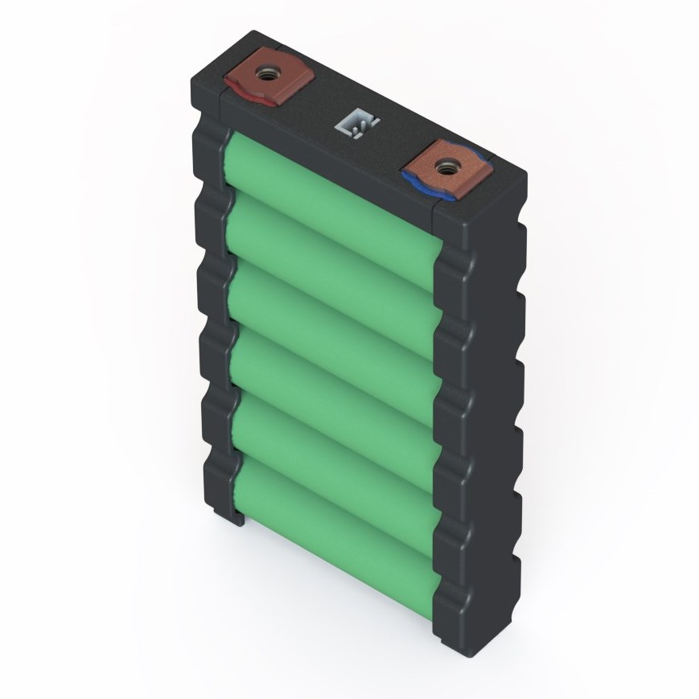
Battery module
The battery pack is composed by several modules, in my case Energus 6p1s Sony VTC5.
Just rough calculations, if I want to discharge the module at 200A (assuming nominal voltage) I need to dissipate 720 W.
Capacity: 15.6 Ah
Nominal voltage: 3.6V
Maximum voltage: 4.2V
Cut-off voltage: 2.5V
Max discharge current: 280A (5s pulse)
Max continuous discharge current: 180A
Notes:
Let’s start by looking at the battery parameters

Slide 4
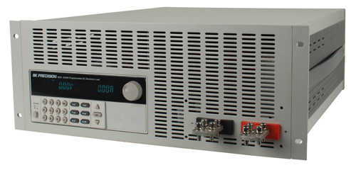
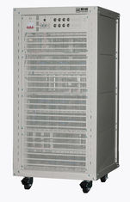
On Market solutions
There are two ways in which the test can be done: using programmable DC loads as:
or can be obtained using very expensive and sophisticated instrumentations (HPPC test instrument)
BK 8600 Series
Max load voltage: 60V-120V
Current: up to 240A
Built-in DAS
Price: 4000$-10000$
Neware CT-4002
Load voltage: 0.025V-5V
Current: up to 300A
Built-in DAS
Price: > 10000$

Slide 5
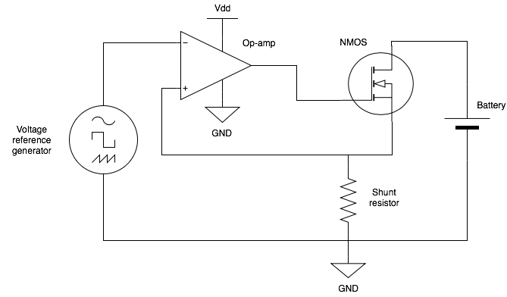
Constant current load
The easiest and cheaper solution that I found was to use the so called ”constant current load”, here the schematic
The basic principle is that the voltage that I apply on the inverting side of the Op-amp is the same that I apply between the resistor’s terminals.
So, if I use a 0.1 Ohm resistor and I apply one Volt as reference voltage the current that flows through the battery, the NMOS and the resistor is 10A.
Notes:
As first thing I created a small constant current and tried to discharge a single Samsung 18650-25R at 15A. The results were good so I started with the design of the bigger one. For this part I used LTSpice for simulating the entire circuit.

Slide 6
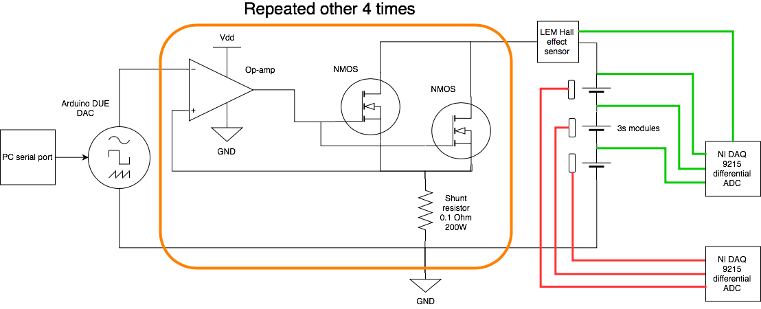
Final circuit diagram
After a long time spent on LTSpice I finally reach the final circuit. The main problems that I found were:
Parallels of mosfets are difficult to manage (parameters mis-matching)
Heat dissipation
Op-amp oscillating behaviour
Finding electrical components which were able to meet my requirements
Notes:
Parallel of mosfets

Slide 7
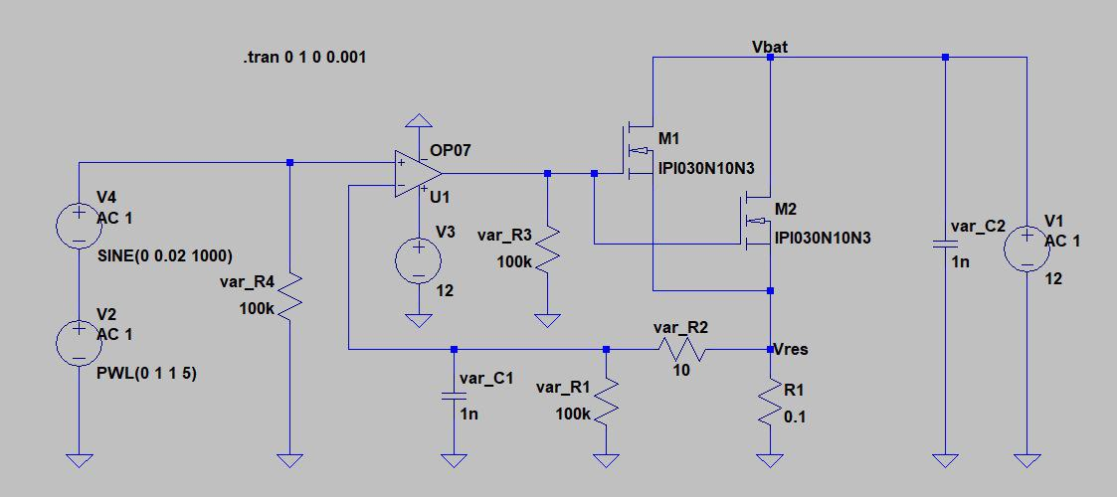
LTSPice schematic
Here the schematic of one of the five circuit’s section:
Noise injection
Standard operational amplifier
Power mosfets
Reference voltage simulator
Power resistor
Battery simulator

Slide 8
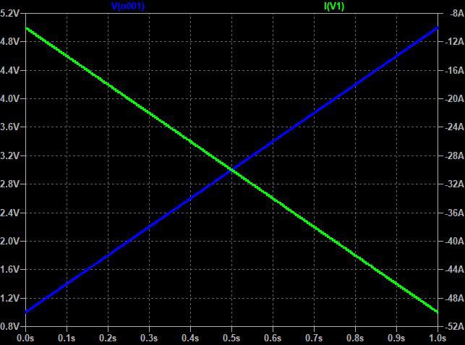
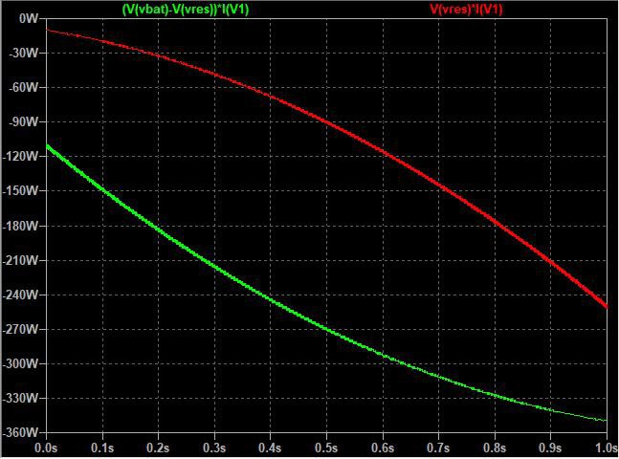
Heat dissipation
From the simulation I found the power that the mosfets and the resistors have to dissipate. Here 2 simulations which show how the current drawn varies with respect to the reference voltage and how the heat power vary with respect to the current draw.
A cooling system was needed.
(Blue: reference voltage Green: current drawn per section)
(Green: mosfet’s power Red: resistor’s power)
Notes:
As shown for low currents most of the power goes inside the resitor (power peak of) while for higher currents are the mosfets that dissipate most of the power.
so I started looking on the market which kind of solution is better. In order to correctly design the cooling I choose the maximum power dissipate for each device. This idea is conservative (explain better)

Slide 9
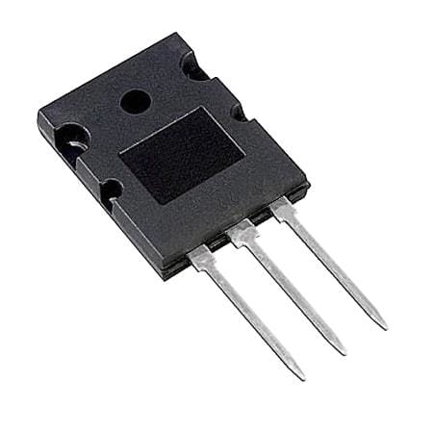
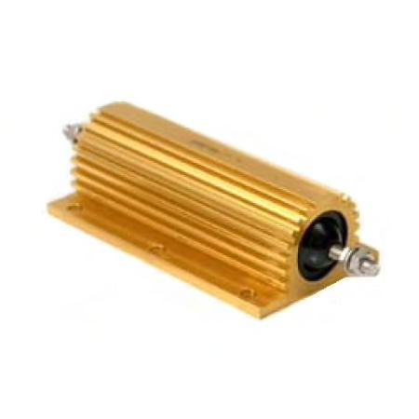
Power Components
The power components were:
10x Mosfet IXIS IXFK360N10T
Rds of 2.9 mOhm
Vdss 100V
Idmax 360A
Pmax 1250 W
Rthjc 0.12W/°C
Rthcs 0.05 W/°C
Vgs(th) 2.5V-4.5V
5x 0.1Ohm +/-5% Arcol HS200 R1 J
200W power rating
50W without cooling

Slide 10
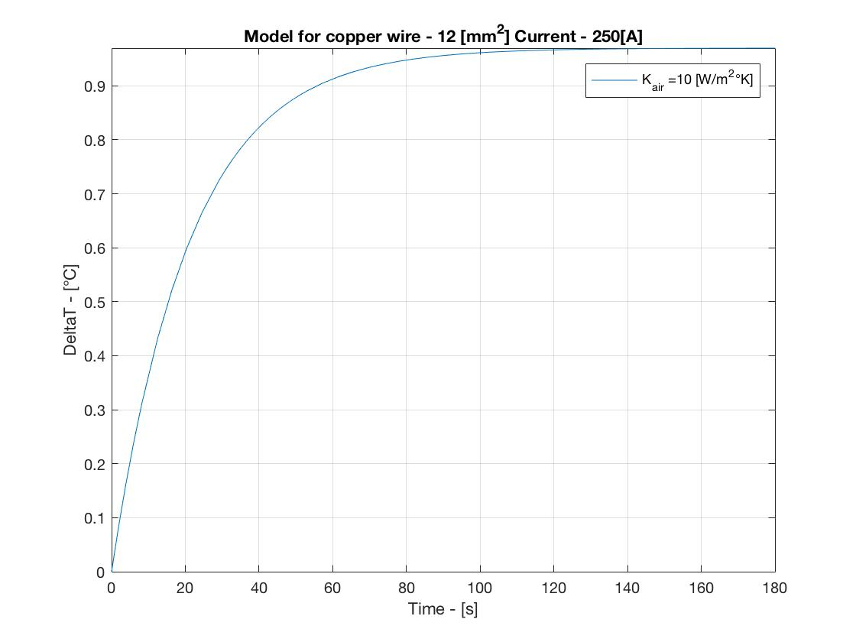
Busbar design
Thanks to ProM I was able to design my own busbar starting from a cupper sheet of 1.5mm thickness. For the design/simulation I used a well known 1DoF thermal model implemented using Matlab, here the final simulation of the positive busbar (1.5m length).

Slide 11
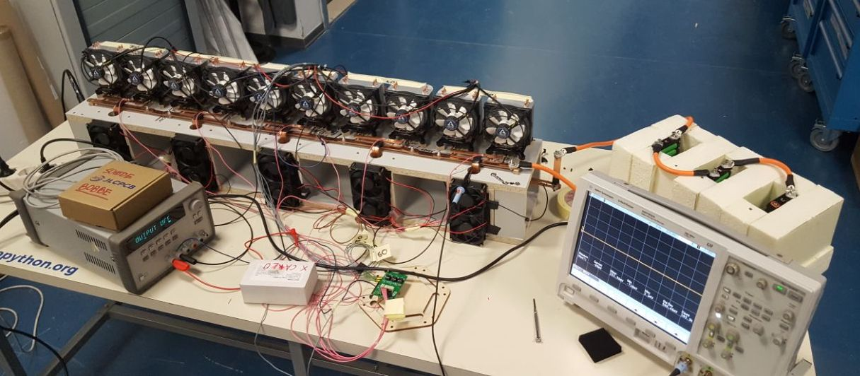
Final result
Cooling system
Batteries and almost adiabatic case
Reference generator
Resistor’s
cooling
Control board

Slide 12
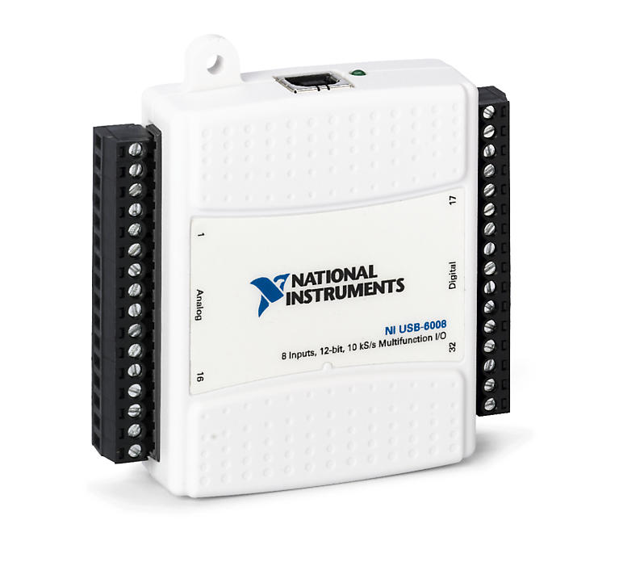
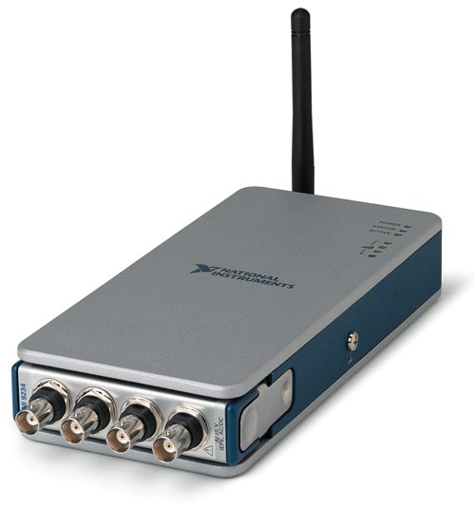
Data logger - Hardware
NI USB-6008
NI cDAQ-9181
USB connection
Up to 8 Differential ADC
+/- 10V range
12 bit of resolution
10 KS/s
TCP/IP connection
Up to 4 Differential ADC
+/- 10V range
16 bit of resolution
100 KS/s
Both the devices were used in differential mode.

Slide 13
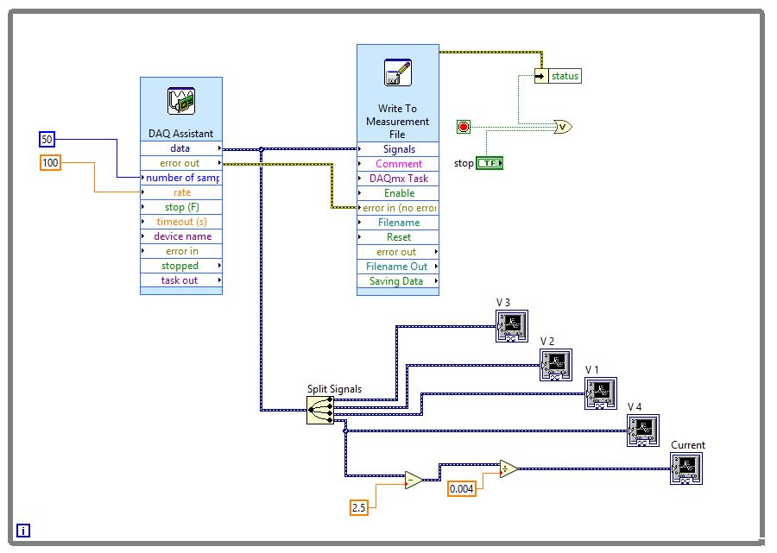
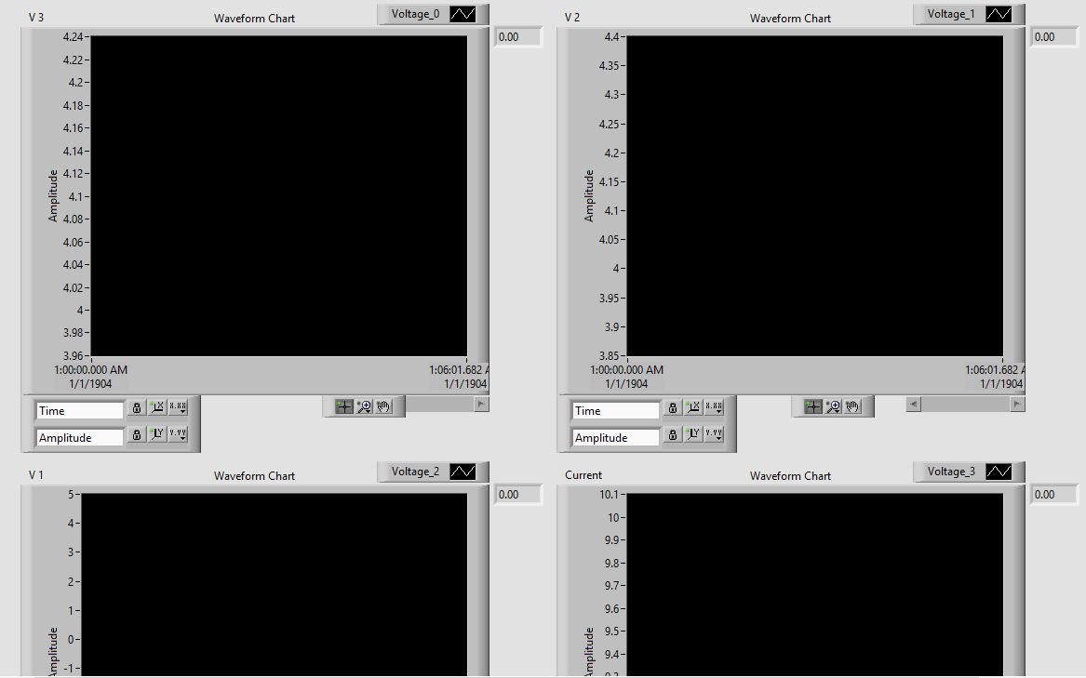
Data logger - software
After choosing and setting the hardware I created the VI which logs and plots all the data. This VI can be used with both hardware.
Code
User interface

Slide 14
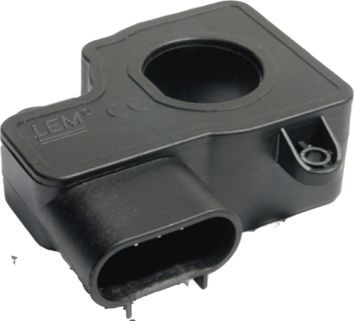
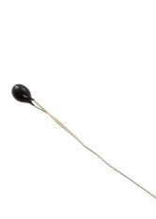
sensors
DHAB-S24 Hall effect current sensor
Single 5V supply
+/- 500A of current range
4mV per Ampere of sensitivity
10K NTC Thermistor B3380 Cantherm
+/- 1% of tolerance
Time constant < 3 seconds
Already wired up

Slide 15
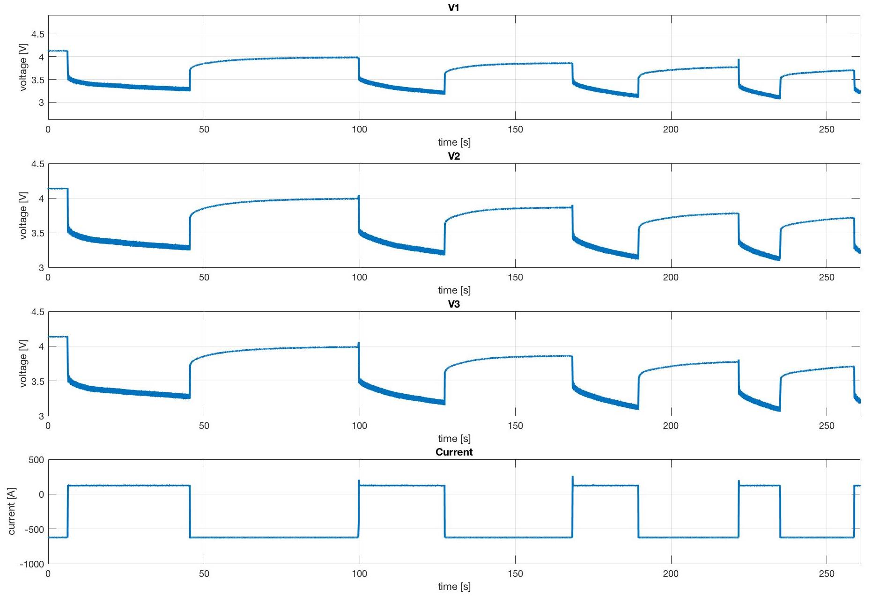
conclusion: Data analysis
Here a slice of a discharge test at 120A sampled at 50 Hz and with a resolution of 3mV.
Batteries
voltages
Current

Slide 16
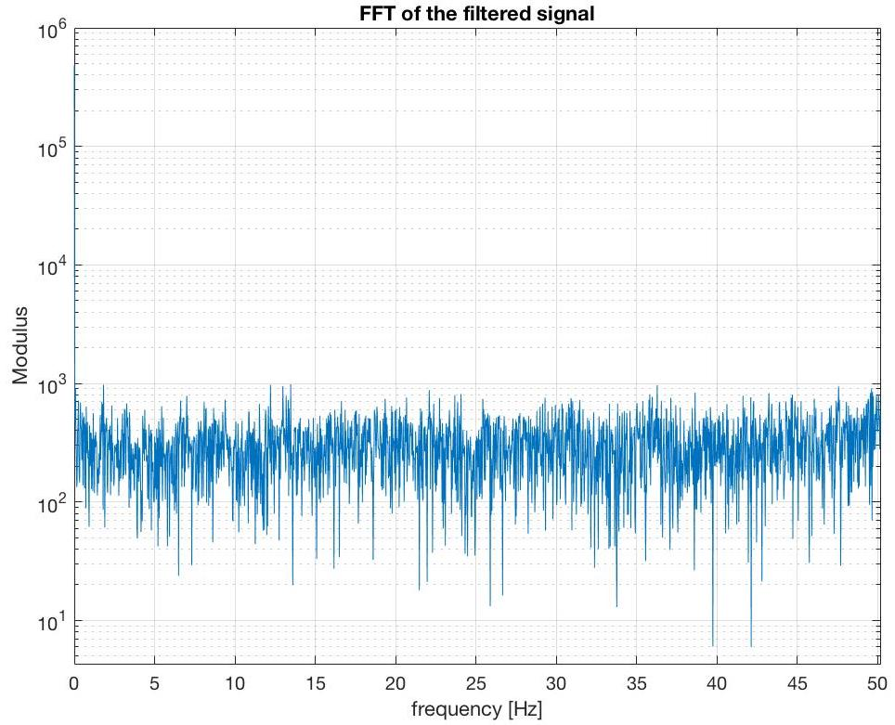
conclusion: Data analysis pt.2
Here the FFT of the current during the discharge pulse without any filtering.
DC component
White noise
Fs = 50 Hz
Resolution = 3mV

Slide 17
Thanks for the attention

